Slide 1
End to End Machine Learning with Python in IBM Watson Studio:
HN ML-Viewer Application
By Greg Filla, @gdfilla
With Adam Massachi
May 10, 2018

Slide 2
Who’s here today?
Data Engineer
Data Scientist
Software Engineer
Just here for the demos

Slide 3



Introductions
Product Manager for IBM Watson Studio
‘Builder’ data scientist
Obsessed with Hacker News ;-)
Excited to cover as much as possible today and any Q&A

Slide 4
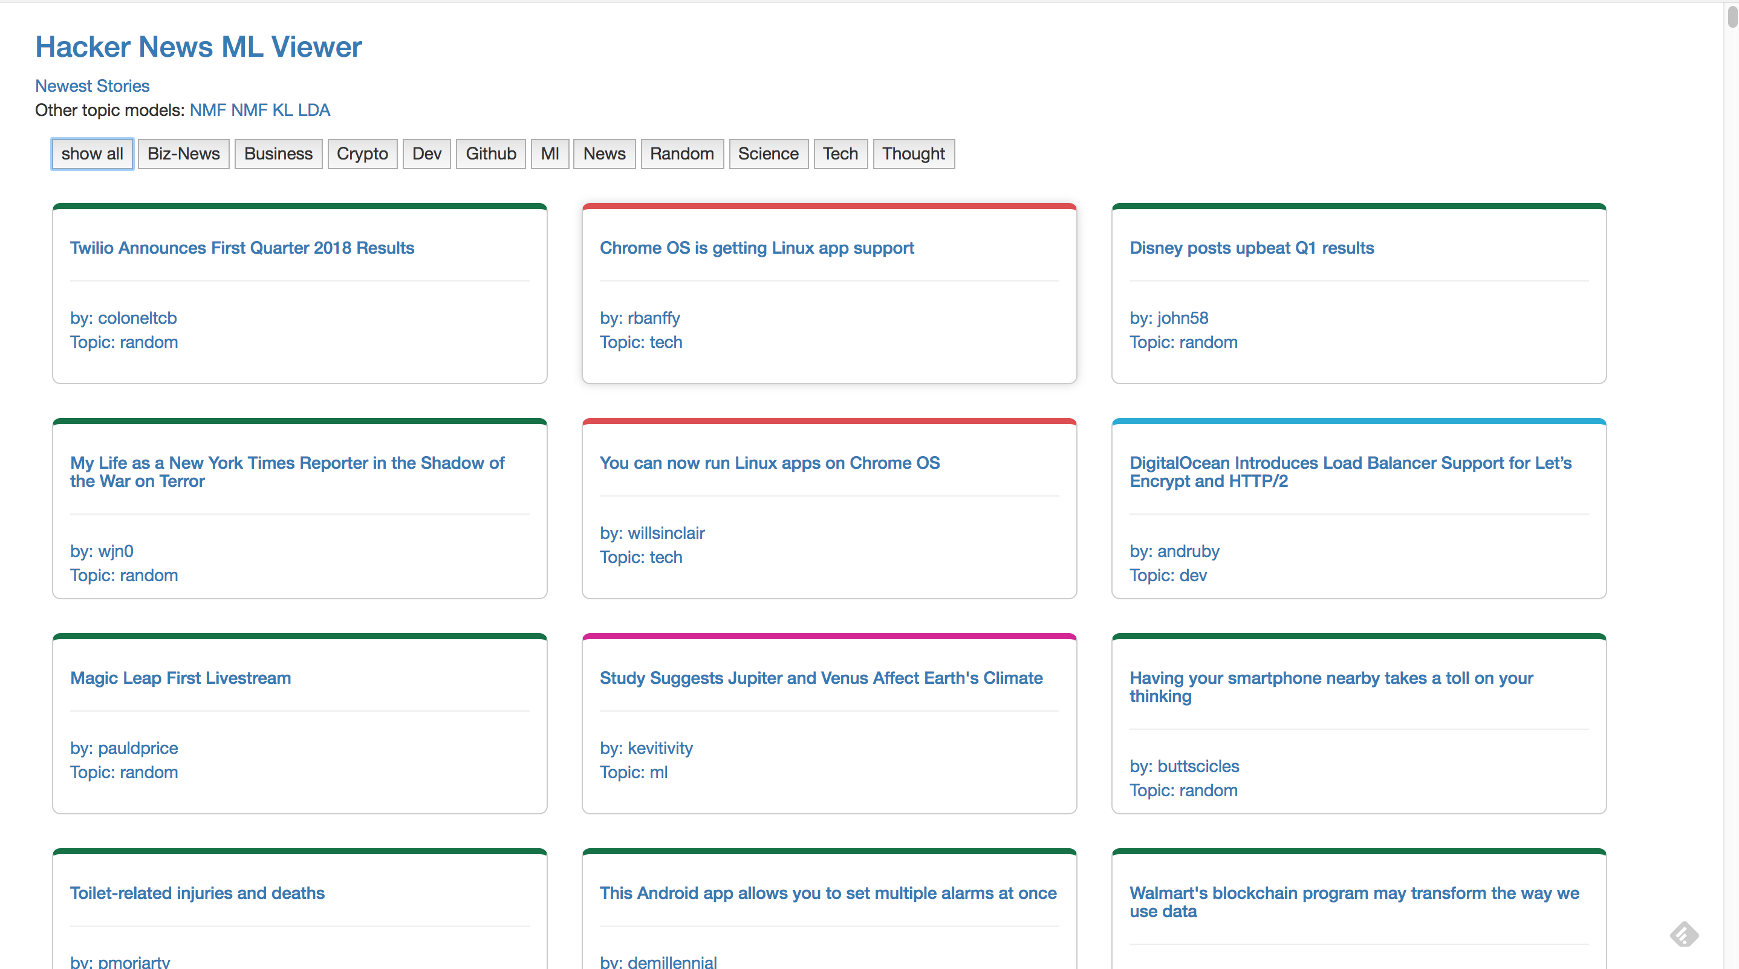

Slide 5



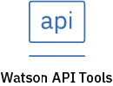


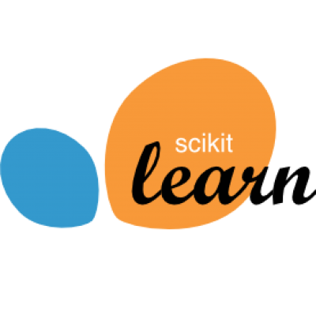






Watson Studio
Tools for supporting the end-to-end AI workflow
Create, collaborate, deploy, and monitor
Best of breed open source & IBM tools
Code (R, Python or Scala) and no-code/visual modeling tools
Authoring Tools
Machine Learning Runtimes
Deep Learning Runtimes
Most popular open source frameworks
IBM best-in-class frameworks
Cloud Infrastructure as a Service
Fully managed service
Container-based resource management
Elastic pay as you go cpu/gpu power
Model Lifecycle Management

Slide 6
Watson: AI for Smarter Business
Watson Business Solutions
Watson Applications
ISV & Third Party Applications
Compliance Assist
Customer Care
Expert Assist
Voice of the Customer
Watson Assistant
Watson Cybersecurity
Compare & Comply
...
...
...
Watson Studio
Watson APIs
Connect & Access Data
Search & Find Relevant Data
Prepare Data (Ingest, Curate, & Enrich)
Build & Train AI Models
Deploy AI Models
Monitor, Analyze, Manage
Continuous Learning
Watson Machine Learning and Deep Learning as a Service
Watson Knowledge Catalog
Watson Enriched Data &
Analytical Assets
Watson Powered Search & Social Collaboration
Active Policy Enforcement
Model Governance,
Traceability & Lineage
Data Kits
Learns from Small data

Slide 7
HN ml-viewer app stages for workshop
Requirements Gathering
Data Collection
Model Building
App Development
Model Integration

Slide 8
Requirements Gathering
Minimum Viable Product – minimum set of functionality for product (application) for it to be valuable for an end user
Value Proposition: Provide a better experience for readers of Hacker News to make it easy to find interesting stories
Defining user stories
As a HN reader I can find stories grouped by meaningful categories so I can find what interests quicker
As a HN reader I can filter stories to hide content I’m not interested in
As a HN reader I can easily view the story content without leaving the application
Prioritize and execute

Slide 9


Data Collection
https://github.com/HackerNews/API
Notebook scheduled in IBM Watson Studio
Find new stories every hour via API
Do rough scrape of each story to pull text
Send new records to IBM Cloud Object Storage as JSON

Slide 10
Data Collection: Details
Append stories for ML model training
Pull new stories from API
GET ids for “new” and “top” stories
For each – GET story details
Scrape text
Save as JSON in Object Storage
Save latest stories for display in app
Future enhancements
look at different feeds besides Hacker News
Improve scraping for better source content
NoSQL Database like Cloudant

Slide 11
Model Building
Sklearn pipeline to cluster new stories to find tags to categorize the content
Experiment with different algorithms to understand data and models
Non-negative Matrix Factorization (NMF)
Latent Dirichlet Allocation (LDA)
Followed this tutorial from the docs (1 of many)
Clustering
Classification (hand-labeling)
Future: tons to experiment with
See deployed model at monkeylearn for this use case

Slide 12
Model Building: Details
Appended stories for ML model training
Topic Models
Non-negative Matrix Factorization
JSON-> DataFrame
Clean data
TFiDF Vectorizer
LDA
Clustering
K-Means
Classification
Review and label
Classification (SVM)

Slide 13
App Development
Using Flask as app framework for it’s simplicity
The app can be tested locally and deployed to IBM Cloud
Model serving is a critical piece of the application
i.e. using the model to categorize new stories

Slide 14
Model Integration
Options for model deployment
Save model in application to load
Save model in object storage
Deploy model with Watson Machine Learning
Online deployment – REST API
Use model repository to load model
How can we update the model over time?
New stories every day – model needs retraining
Allow users to help categorize stories in app UI

Slide 15
Thank you!
Questions?

